Slide 1


Tomatometer
Popcornmeter
vs
Amanda Roman
DA14

Slide 2
TABLE OF CONTENTS
01. INTRODUCTION
02. TRENDS
03. GENRES
04. DIRECTORS
Data Analysis Process
Rotten Tomatoes Scoring
Q: Has the divergence between critic and audience reviews increased over time?
Q: Which genres are more susceptible to the gap between critic and audience?
Q: Do critic and audience reviewers favor different directors?
05. BOX OFFICE
06. AWARDS
07. CONCLUSION
THANK YOU!
Q: Do audience ratings have a stronger correlation to box office numbers?
Q: Do critic ratings have a stronger correlation to awards won?
Summary
Selecting Movies
Rotten Tomatoes: Tomatometer vs. Popcornmeter
Amanda Roman, DA14

Slide 3

01
INTRODUCTION
Rotten Tomatoes: Tomatometer vs. Popcornmeter
Amanda Roman, DA14

Slide 4
ROTTEN TOMATOES SCORING
INTRODUCTION
FRESH
Critic Reviews
60% or more reviews are positive (3.5 or more out of 5)
90% score means 90% of critic reviewers rated the movie 3.5/5 or higher
ROTTEN
Critic Reviews
Less than 60% reviews are positive (3 or less out of 5)
23% score means 23% of critic reviewers rated the movie 3/5 or lower
HOT
Audience Reviews
60% or more reviews are positive (3.5 or more out of 5)
85% score means 85% of audience reviewers rated the movie 3.5/5 or higher
STALE
Audience Reviews
Less than 60% reviews are positive (3 or less out of 5)
30% score means 30% of audience reviewers rated the movie 3/5 or lower
Rotten Tomatoes: Tomatometer vs. Popcornmeter
Amanda Roman, DA14

Slide 5
DATA ANALYSIS PROCESS
INTRODUCTION
DATA GATHERING
COMPARISON GROUPS
Rotten Tomatoes master file from 3 individual datasets
Box Office dataset
Academy Awards dataset
1.
2.
3.
Critic Fresh
Audience Stale
DATA CLEANING
Joined box office and award info to master file
Removed duplicates
Added in missing data
DATA ANALYSIS
Audience Hot
Critic Splat
Split master file into 3 comparison groups according to critic/audience reviews
Data parameters -
Language: English
Length: 75+ minutes
Years: 1940-2022
Total 14,475 movies
Critic Fresh
Audience Hot
Rotten Tomatoes: Tomatometer vs. Popcornmeter
Amanda Roman, DA14

Slide 6
DATA ANALYSIS PROCESS
INTRODUCTION
DATA GATHERING
COMPARISON GROUPS
Rotten Tomatoes master file from 3 individual datasets
Box Office dataset
Academy Awards dataset
1.
2.
3.
DATA CLEANING
Critic
Joined box office and award info to master file
Removed duplicates
Added in missing data
DATA ANALYSIS
Audience
Split master file into 3 comparison groups according to critic/audience reviews
Data parameters -
Language: English
Length: 75+ minutes
Years: 1940-2022
Total 14,475 movies
Critic
Audience
Rotten Tomatoes: Tomatometer vs. Popcornmeter
Amanda Roman, DA14

Slide 7
02
TRENDS
Rotten Tomatoes: Tomatometer vs. Popcornmeter
Amanda Roman, DA14

Slide 8
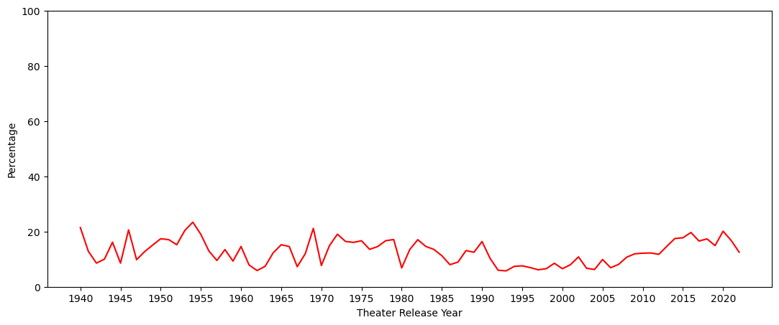
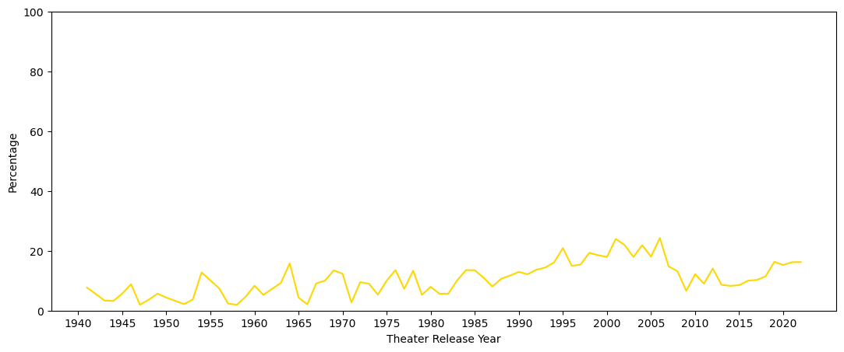
Q: Has the divergence between critic and audience reviews increased over time?
Percentage Movies Released Over Time
TRENDS
Increase from
7% to 20%
(1992-2016)
Critic
The percentage of movies in both Critic Fresh and Audience Hot have upward trajectories from 1990s onward
More data needed to determine if upward percentage trend is changing
Increase from
5% to 24%
(1979-2006)
Audience
Rotten Tomatoes: Tomatometer vs. Popcornmeter
Amanda Roman, DA14
Notes:
Critic Fresh
-1992-2005 steady ~7%, Couple spikes ~10%
-2006-2016 increase from 7% to 20%
-Peaks: 20%: 2020, 2016, 1953 / 21%: 1940, 1946, 1969 / 23%: 1954

Slide 9
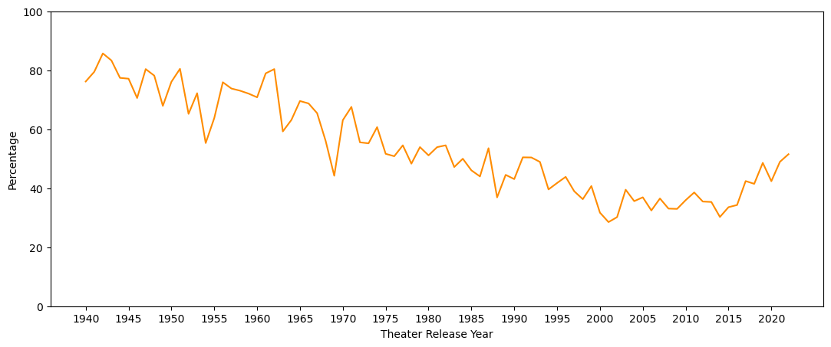
Q: Has the divergence between critic and audience reviews increased over time?
TRENDS
Percentage Movies Released Over Time
Increase from
30% to 52%
(2014-2022)
Clear downward trend in percentage of movies rated positively by both audiences and critics until 2014
Trend is reversing in recent years as percentage began increasing in 2015
Critic Fresh + Audience Stale at its lowest percentage, 28%, is still higher than all Critic Fresh and Audience Stale peaks
Critic
Audience
Rotten Tomatoes: Tomatometer vs. Popcornmeter
Amanda Roman, DA14

Slide 10
03
GENRES
Rotten Tomatoes: Tomatometer vs. Popcornmeter
Amanda Roman, DA14

Slide 11
Q: Which genres are more susceptible to the gap between critic and audience?
Drama | 23%
Comedy | 17%
Mystery & Thriller | 10%
Documentary | 7%
Action | 5%
GENRES
Overall
Drama | 25%
Comedy | 17%
Mystery & Thriller | 13%
Horror | 9%
Documentary | 5%
Drama, Comedy, Mystery & Thriller appear in top 5 across the board
Horror genre only appears in top 5 in Critic Fresh
Documentary drops out of Audience Hot and is replaced by Romance and Action
Critic Fresh + Audience Hot genre breakdown looks similar to the Overall breakdown
Critic
Drama | 27%
Comedy | 18%
Mystery & Thriller | 8%
Romance | 7%
Action | 7%
Audience
Drama | 26%
Comedy | 15%
Documentary | 12%
Mystery & Thriller | 6%
Adventure | 4%
Critic
Audience
Rotten Tomatoes: Tomatometer vs. Popcornmeter
Amanda Roman, DA14

Slide 12
04
DIRECTORS
Rotten Tomatoes: Tomatometer vs. Popcornmeter
Amanda Roman, DA14

Slide 13

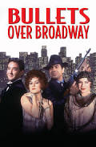







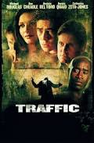

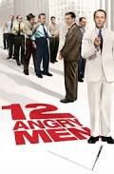
Q: Do critic and audience reviewers favor different directors?
Overall
DIRECTORS
Woody Allen
48
Clint Eastwood
38
Top 6 movie directors Overall
Number of movies directed ranges from 32 to 48
List includes several well-known names
Steven
Spielberg
35
Martin Scorsese
34
Steven Soderbergh
34
Sidney Lumet
33
Rotten Tomatoes: Tomatometer vs. Popcornmeter
Amanda Roman, DA14

Slide 14
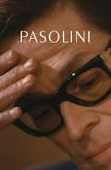


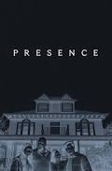

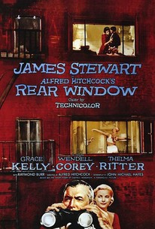


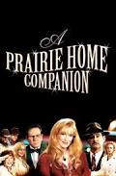
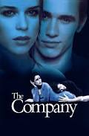

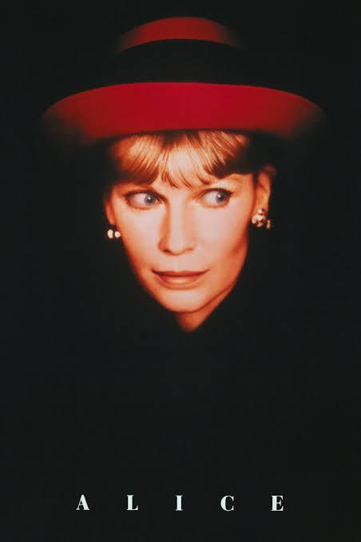

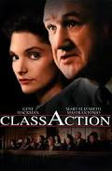
Q: Do critic and audience reviewers favor different directors?
Critic
DIRECTORS
Abel
Ferrara
10
Steven Soderbergh
9
Top 6 movie directors in Critic Fresh
Low number of movies, only ranges from 6 to 10
Woody Allen and Steven Soderbergh appear in both Overall and Critic Fresh
15% of Woody Allen’s movies were liked by critics and not audiences
26% of Steven Soderbergh’s
David Cronenberg
7
Robert
Altman
7
Woody Allen
7
Michael Apted
6
Rotten Tomatoes: Tomatometer vs. Popcornmeter
Amanda Roman, DA14
Notes:
Total list: 2619
# movies in top 6: 37

Slide 15
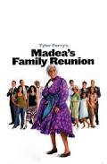











Q: Do critic and audience reviewers favor different directors?
Audience
DIRECTORS
Tyler
Perry
14
Michael
Bay
7
Top 6 movie directors in Audience Hot
Low number of movies, ranges from 6 to 14
Romance and action movies, fan followings, and niche markets
No director shows up in both Audience Hot and Overall
Tyler Perry directed 21 movies overall, 61% of his movies were liked by audiences and not critics
Ridley Scott
6
Tony
Scott
6
Sean McNamara
6
Peter
Segal
6
Rotten Tomatoes: Tomatometer vs. Popcornmeter
Amanda Roman, DA14
Notes:
Total list: 2111
# movies in top 6: 41

Slide 16
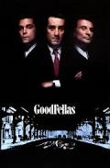




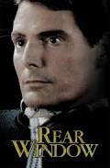




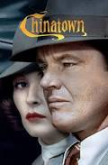

Q: Do critic and audience reviewers favor different directors?
Critic
Audience
DIRECTORS
Martin Scorsese
31
Steven Spielberg
27
Top 6 movie directors in Critic Fresh + Audience Hot
Higher number of movies, ranges from 23 to 31
Woody Allen is a top director in both Critic Fresh + Audience Hot and Critic Fresh
91% of Martin Scorsese’s movies were liked by both critics and audiences
Alfred Hitchcock
25
Woody
Allen
24
Clint Eastwood
23
John
Huston
23
Rotten Tomatoes: Tomatometer vs. Popcornmeter
Amanda Roman, DA14
Notes:
Total list: 5589

Slide 17
05
BOX OFFICE
Rotten Tomatoes: Tomatometer vs. Popcornmeter
Amanda Roman, DA14

Slide 18
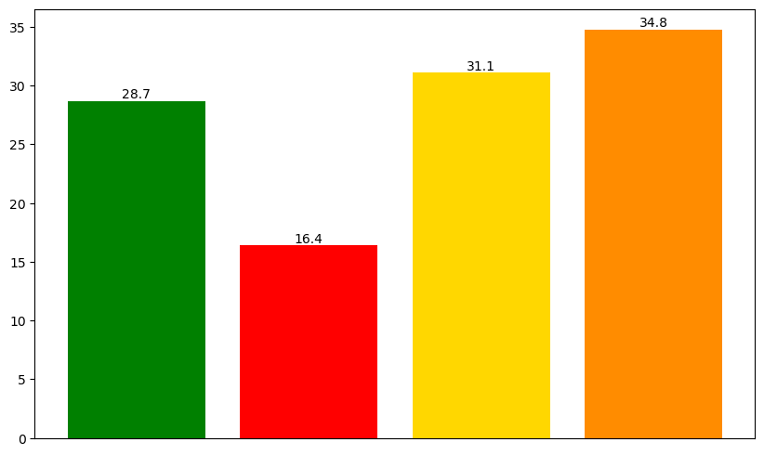
Q: Do audience ratings have a stronger correlation to box office numbers?
Average Domestic Box Office Numbers by Review Category
BOX OFFICE
Critic Fresh movies produce lower numbers at the domestic box office, average of $16.4M compared to $28.7M Overall average and 43% less than Overall
Critic Fresh + Audience Hot movies on average bring in the most domestic money with $34.8M, 21% more than Overall
Domestic Box Office (Millions)
Overall
*Box office numbers have not been adjusted for inflation
Critic
Audience
Critic
Audience
Rotten Tomatoes Review Categories
Rotten Tomatoes: Tomatometer vs. Popcornmeter
Amanda Roman, DA14

Slide 19
06
AWARDS
Rotten Tomatoes: Tomatometer vs. Popcornmeter
Amanda Roman, DA14

Slide 20
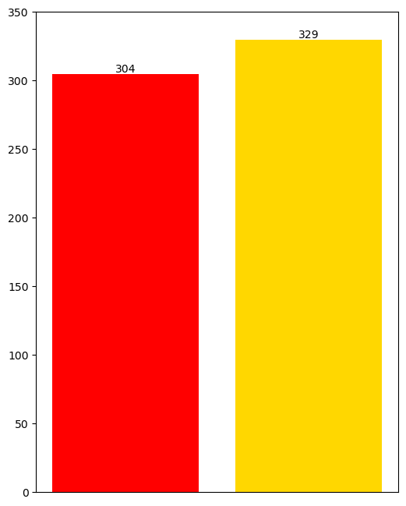
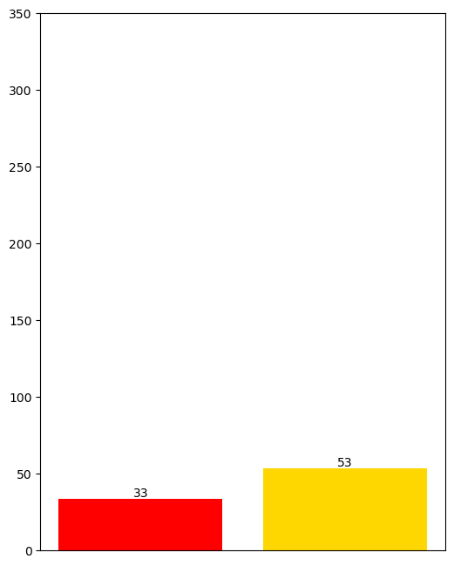
Q: Do critic ratings have a stronger correlation to awards won?
Oscar Award Nominations
Oscar Award Wins
AWARDS
Audience Hot has slightly more nominations than Critic Fresh with 329 total Oscar nominations
More wins occur in Audience Hot than in Critic Fresh with 53 total wins, a 61% increase over Critic Fresh’s 33 wins
Critic
Audience
Critic
Audience
Rotten Tomatoes: Tomatometer vs. Popcornmeter
Amanda Roman, DA14

Slide 21
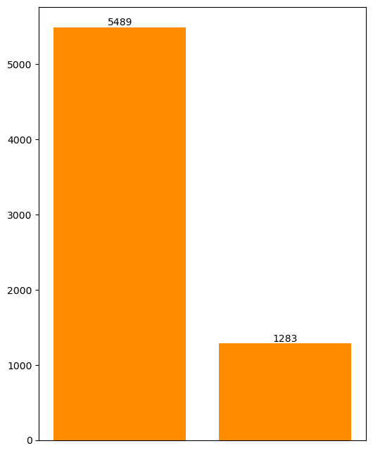
Q: Do critic ratings have a stronger correlation to awards won?
AWARDS
Critic
Audience
Win Percentage
11%
Critic
Critic Fresh + Audience Hot has over 16 times more nominations and over 24 times more wins than either Critic Fresh or Audience Hot
Audience Hot has a higher wins percentage than Critic Fresh
Critic Fresh + Audience Hot has the highest win percentage at 23%
16%
Audience
23%
Critic
Audience
Nominations
Wins
Rotten Tomatoes: Tomatometer vs. Popcornmeter
Amanda Roman, DA14

Slide 22
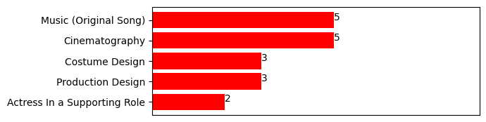
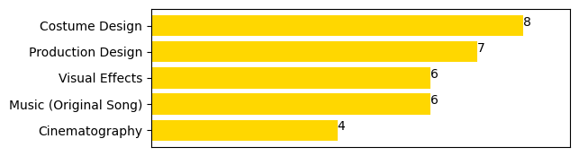
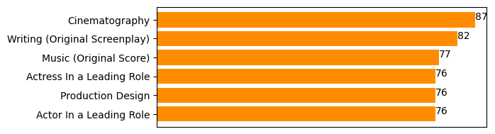
Q: Do critic ratings have a stronger correlation to awards won?
Highest Number of Oscar Award Wins
AWARDS
Critic
Visual Effects only makes the top 5 in Audience Hot
Writing (Original Screenplay) and Actress/Actor in a Leading Role are three significant awards that only appear as top awards in Critic Fresh + Audience Hot
Cinematography and Production Design appear in top 5 all three categories
Audience
Critic
Audience
*Discontinued award names have been converted to present day names
Rotten Tomatoes: Tomatometer vs. Popcornmeter
Amanda Roman, DA14
Notes:
e.g. Art Direction, Art Direction (Black-And-White), Art Direction (Color) → Production Design

Slide 23
Q: Do critic ratings have a stronger correlation to awards won?
AWARDS
Most Prestigious Oscar Awards
Critic
Audience
Critic
Audience
Best Picture
2
0
71
Directing
1
0
74
The most prestigious Oscar awards are awarded significantly more to Critic Fresh + Audience Hot
Best Picture and Directing have never been won by Audience Hot
Only 3 Audience Stale Best Picture winners
Tom Jones (1963)
Around the World in 80 Days (1956)
The Greatest Show on Earth (1952), also a Critic Splat
Actor in a Leading Role
0
2
76
Actress in a Leading Role
1
1
76
Original Screenplay
1
2
82
Total
5
5
379
Rotten Tomatoes: Tomatometer vs. Popcornmeter
Amanda Roman, DA14

Slide 24
07
CONCLUSION
Rotten Tomatoes: Tomatometer vs. Popcornmeter
Amanda Roman, DA14

Slide 25
SUMMARY
CONCLUSION
1. There is a trending gap between critics and audiences.
2. And there are some clear preferences between critics and audience.
3. But critics + audiences both influence box office numbers and awards.
TRENDS
GENRES
BOX OFFICE
Gap between critics and audiences has been increasing
Movies rated positively by both critics and audiences have decreased, but there is a recent upward trend
Everyone likes Drama, Comedy, Mystery & Thriller movies
Critics prefer Horror more whereas audiences like Romance and Action
Box office numbers suffer if audiences don’t like a movie
Highest box office numbers result from both audiences and critics liking a movie
DIRECTORS
AWARDS
Clear distinction between directors in each category
Movie directors liked by audiences and not critics are most often in niche market segments or about narrow-interest topics
Audiences alone drive more wins than critics alone
Highest number of awards and the most prestigious awards overwhelmingly go to movies with both high audience and critic reviews
Rotten Tomatoes: Tomatometer vs. Popcornmeter
Amanda Roman, DA14

Slide 26
SELECTING
MOVIES
CONCLUSION
CRITIC FRESH
AUDIENCE HOT
CRITIC FRESH + AUDIENCE HOT
CRITIC FRESH
AUDIENCE HOT
CRITIC FRESH + AUDIENCE HOT
Fan of a movie director
Interest in low-budget films
Enjoy the horror film genre
In a niche market or topic
Children’s movies
Politically-leaning movies
Religious movies
Fan of the book, comic or movie series
Enjoy action or romance movies
Highest odds of enjoying a movie if both critics and audiences rated it positively
Enjoy blockbuster movies
Want to watch award show nominees
Critic
Audience
Critic
Audience
Rotten Tomatoes: Tomatometer vs. Popcornmeter
Amanda Roman, DA14

Slide 27
Thank You!
Rotten Tomatoes: Tomatometer vs. Popcornmeter
Amanda Roman, DA14

Slide 28






Slide 29
SUMMARY
CONCLUSION
TRENDS
DIRECTORS
AWARDS
Gap between critics and audiences has been increasing
Movies rated positively by both critics and audiences have decreased, but there is a recent upward trend
Clear distinction between directors in each category
Movie directors liked by audiences and not critics are most often in niche market segments or about narrow-interest topics
Audiences alone drive more wins than critics alone
Highest number of awards and the most prestigious awards overwhelmingly go to movies with both high audience and critic reviews
Critics have historically influenced Best Picture slightly more than audiences
GENRES
BOX OFFICE
Everyone likes Drama, Comedy, Mystery & Thriller movies
Critics prefer Horror more whereas audiences like Romance and Action
Box office numbers suffer if audiences don’t like a movie
Highest box office numbers result from both audiences and critics liking a movie
Rotten Tomatoes: Tomatometer vs. Popcornmeter
Amanda Roman, DA14

